Slide 1
Ontologies for Reasoning about Failures in AI Systems
Matthew D. Schmill, Tim Oates, Dean Wright
University of Maryland Baltimore County
Don Perlis, Shomir Wilson, Scott Fults
University of Maryland
Michael Anderson
Franklin & Marshall College
Darsana Josyula
Bowie State University

Slide 2
Brittleness
Brittleness is the propensity of an agent to perform poorly or fail outright in the face of unanticipated changes

Slide 3
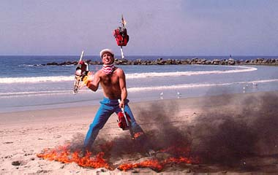
People: not very brittle

Slide 4
People: not very brittle
(this guy is juggling chainsaws in a ring of fire)

Slide 5

AI Systems: maybe just a bit on the brittle side
the complexities of real-world environments
are difficult to account for in advance
organization and integration of multiple,
varied cognitive components a challenging
task

Slide 6
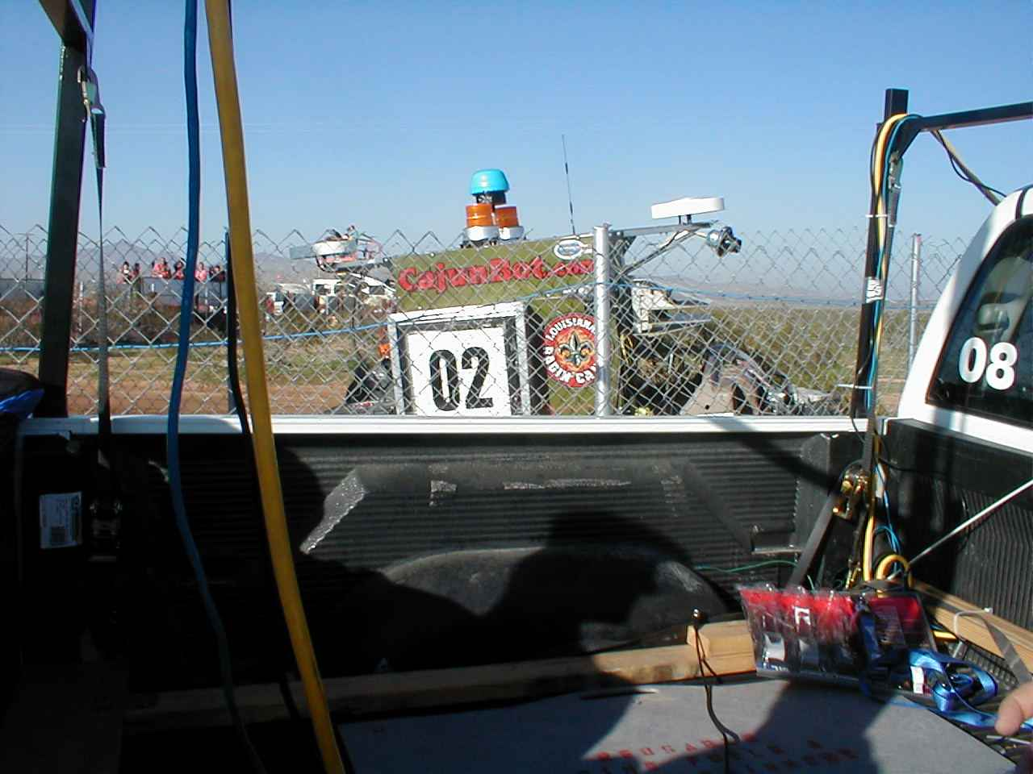
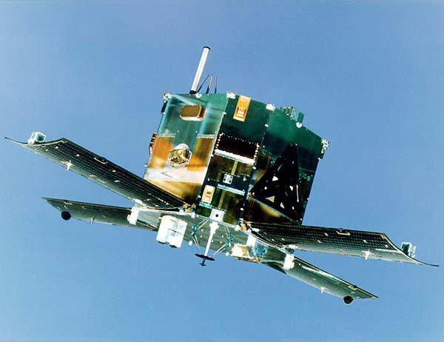
Failures and Self-Ignorance

Slide 7
Perturbation Tolerant Systems
A perturbation is any unanticipated change, either
in the world or in the system itself, that impacts an agent’s performance.
Perturbation tolerance is the ability of a system to quickly recover from perturbations.
How can we endow AI systems with human-like perturbation tolerance?
Notes:
Maintaining adequate performance in the face of problems and perturbations—whether caused by unexpected circumstances in the environment or by internal malfunctions—has been a perennial stumbling block for intelligent systems, and an ongoing challenge for AI. A typical AI system designed for a specific task often fails utterly when circumstances take it even slightly outside its task specifications. We believe this long-standing problem has two fundamental roots: self-ignorance and brittleness.

Slide 8
Intuition
Based on observations in human problem solving
Generic formula for perturbation tolerance:
  notice something is different
  assess the situation
  decide how to
    React
    Adapt

Slide 9
The MetaCognitive Loop
An architecture for perturbation tolerance
Allows a system to declare expectations
MCL continuously monitors expectations and
  notices when they are violated
  assesses the cause of the violation
  guides the host system to an appropriate response

Slide 10
Prior Work
MCL as a tightly coupled system component
  human-computer dialog (ALFRED)
  reinforcement learning (Chippy)
  game playing (Bolo)
MCL in these systems
  had specific knowledge of the host system (domain) sufficient to properly respond to anomalies

Slide 11
Current Work
Proof-of-concept work involved domain-specific instantiations of MCL
The benefits of adding a metacognitive loop must outweigh the cost of incorporating it
Current work is toward domain-neutrality
  a single MCL that can be integrated with a variety of systems at a low cost

Slide 12
Domain Neutrality
The roads to recovery in different domains share concepts at some level of abstraction
  indications – contextual signal of an anomaly
    “a sensor failed to change as expected”
  failures – underlying cause of indications
    “the sensor is malfunctioning”
  responses – actions required to recover from and prevent anomaly
    “revise models to use alternate sensors”

Slide 13
Domain Neutral MCL
Indications, Failures, and Responses ontologies
  nodes represent concepts at many levels of abstraction
  expressing various relationships between concepts
  implemented as graphical models
Note, Assess, and Guide steps use the ontologies
  ontologies are now Bayes networks
  concepts have associated beliefs indicating the belief
  that they are true in the context of the current anomaly

Slide 14
Domain Neutral MCL
Move from concrete indications to abstract
Reason about underlying failures at an abstract,
domain-neutral level
Move from abstract repairs to concrete ones that can be
implemented by the host
indications
failures
responses
expectations
actionable

Slide 15
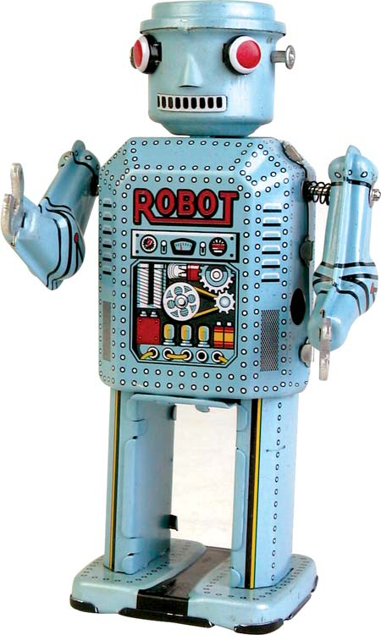
MCL Overview
initialize: the host declares its sensing, acting,
and cognitive capabilities to MCL
MCL
host
specifications
indications
failures
responses
expectations
actionable

Slide 16
Declaring Expectations
step 1: when the host decides to act, it declares
its expectations about what will happen
MCL
host
indications
failures
responses
expectations
concrete
action: move-to <N39 07.607 W077 18.853>
expectation: at-completion, location = N39 07.607 W077 18.853
expectation: distance-to-goal decreases
expectation: action completes in < 2 minutes

Slide 17
Monitoring
step 2: as the action unfolds, MCL monitors
the state of the expectations
MCL
host
indications
failures
responses
expectations
concrete
monitor

Slide 18

Violation
step 3: the agent encounters some ice, which
slows its progress, violating an expectation
MCL
host
indications
failures
responses
expectations
concrete
action: move-to <N39 07.607 W077 18.853>
expectation: at-completion, location = N39 07.607 W077 18.853
expectation: distance-to-goal decreases
expectation: action completes in < 2 minutes

Slide 19
Violation
step 3: the agent encounters some ice, which
slows its progress, violating an expectation
MCL
host
indications
failures
responses
expectations
concrete
(this is ice)
action: move-to <N39 07.607 W077 18.853>
expectation: at-completion, location = N39 07.607 W077 18.853
expectation: distance-to-goal decreases
expectation: action completes in < 2 minutes

Slide 20
Indication
step 4: the properties of the expectation and how
it is violated are used to create an initial configuration of
the indications ontology
MCL
host
indications
failures
responses
expectations
concrete

Slide 21
Indication Ontology
Violation Type:
miss/unchanged
Violation Type:
CWA Violation
Violation Type:
long of target
Violation Type:
missed target
Violation Type:
divergence
Violation Type:
short of target
Violation:
Duration
<
2mins
Indication:
deadline missed
Source Type:
sensor
Source Type:
temporal
Source Type:
reward
Data Type:
continuous
(actual ontology currently has 50+ nodes)

Slide 22
Inference: Failures
step 5: the connectivity between the indications ontology
and the failure ontology allows MCL to hypothesize
the underlying failure
MCL
host
indications
failures
responses
expectations
concrete

Slide 23
Failure Ontology
failure:
sensor error
failure:
predictive m.e.
failure:
knowledge error
failure:
model error
failure:
procedural m.e.
Indication:
deadline missed
failure:
eff. malfunction
failure:
effector error
failure:
effector noice
(from indication ontology)
failure:
resource error
failure:
resource surfeit
failure:
resource defecit
(actual ontology currently has 25+ nodes)

Slide 24
Inference: Responses
step 6: the connectivity between the failure ontology
and the response ontology allows MCL to generate
beliefs that a particular response will fix the anomaly
MCL
host
indications
failures
responses
expectations
concrete

Slide 25
Response Ontology
concrete
response:
revise expectations
failure:
predictive m.e.
concrete
response:
set γ
failure:
procedural m.e.
response:
amend model
response:
modify model
concrete
response:
reset policy
failure:
eff. malfunction
response:
rebuild model
concrete
response:
rerun m.g.a.
(from failure ontology)
concrete
response:
eff. diagnostic
(actual ontology will have many nodes)

Slide 26
Response Ontology
concrete
response:
revise expectations
failure:
predictive m.e.
concrete
response:
set γ
failure:
procedural m.e.
response:
amend model
response:
modify model
concrete
response:
reset policy
failure:
eff. malfunction
response:
rebuild model
concrete
response:
rerun m.g.a.
(from failure ontology)
concrete
response:
eff. diagnostic
(only those nodes actionable by the host will be active)

Slide 27
Response Generation
step 6: MCL computes the utility associated with each
concrete response available to the host and selects the highest
utility response
MCL
host
indications
failures
responses
expectations
concrete
response: perform effector diagnostic
addresses: effector malfunction

Slide 28
Feedback
step 7: the host implements the response.
if the response fails, MCL treats the feedback as evidence
against it in the underlying Bayes nets.
MCL
host
indications
failures
responses
expectations
concrete
feedback from response

Slide 29
Interactive Repair
MCL and the host iterate over responses
until one is found that prevents the anomaly from
occurring again.
MCL
host
indications
failures
responses
expectations
concrete
highest utility response
feedback from response

Slide 30
Current State
Trimmed-down ontologies implemented with
simple Bayes inference
  Deployed in testbed applications
Transferring to openPNL-based Bayes Net
Redeploying PNL-based dnMCL
  Reinforcement learning
  Bolo player
  Dialog agent

Slide 31
Conclusion
Lots of evidence that a meta-level monitor and control
can make AI systems more robust, more efficient
  Anderson, Perlis et al.
  Goel, Stroulia, Murdock, et al.
Our intuition
  Concepts used in reasoning about anomalies
  generalize across domains
  Encode these concepts into ontologies,
  use Bayesian techniques to endow AI systems
  to reason about and recover from their own failures

Slide 32
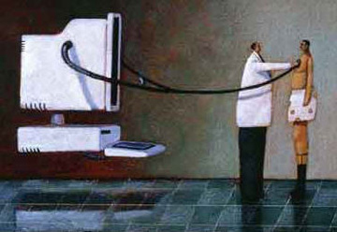
Future Work
Deploy dnMCL on new domains
Expand ontologies
Learn expectations
Recursive MCL
  Expectations about repairs & failures
Evaluation methods

Slide 33

Mahalo nui loa

Slide 34
Reinforcement Learning
Chippy is a reinforcement learner who learns an action policy in a reward-yielding grid world domain.
He maintains expectations for rewards
  average reward
  average time between rewards
If his experience deviates from his expectations
(due to changing the reward schedule) he assesses the anomaly and chooses from a range of responses
  increase learning rate
  increase exploration rate
  start learning from scratch
Notes:
We have also applied MCL to reinforcement learning. In one set of experiments recently completed, we created a standard and an MCL-enhanced reinforcement learner (using Q-learning, SARSA, and Prioritized Sweeping), put them in an 8x8 grid world, allowed them to learn a policy, and then perturbed the world by changing the reward values. The MCL reinforcement learner, in contrast to the standard one, was able to notice that something was wrong, and take specific steps to overcome the problem.

Slide 35
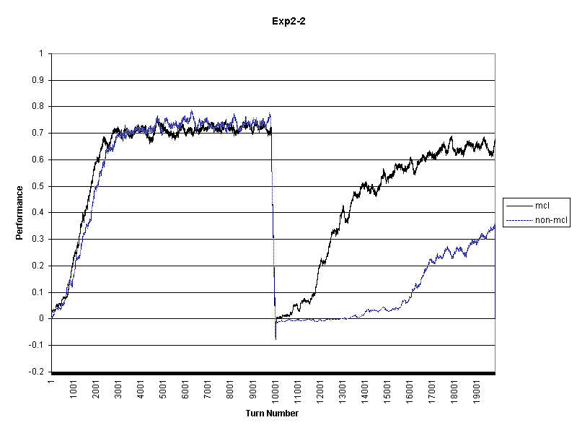
Comparison of the per-turn performance of non-MCL and simple-MCL
with a perturbation moving the locations and degrees of rewards in turn 10,001.

